Slide 1

CKKS Scheme
By
Francisco Soriano

Slide 2
About
CKKS - Cheon-Kim-Kim-Song
Works on fixed-point real numbers.
Allows us to perform computations on vectors of real and complex values.
Works with polynomials because it provides a good trade-off between security and efficiency.
Provides several operations that can be performed on encrypted messages such as addition, multiplication, and rotation.
To have a solid understanding of CKKS, it is important to consider Linear Algebra and Ring Theory.
Linear Algebra
The branch of mathematics aimed at solving systems of linear equations with a ﬁnite number of unknowns.
Ring Theory
Ring - a set of elements where you can add, subtract, and multiply. These sets fall under one of two camps: “number systems” and “functions”.

Slide 3
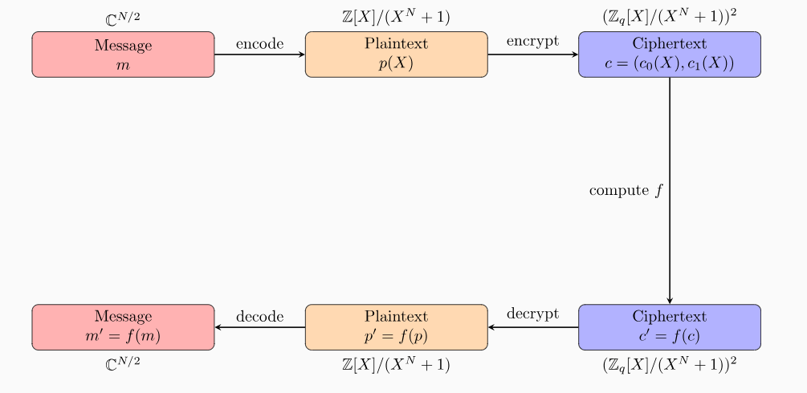
Image by Huynh, Daniel

Slide 4
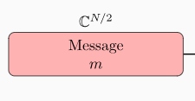
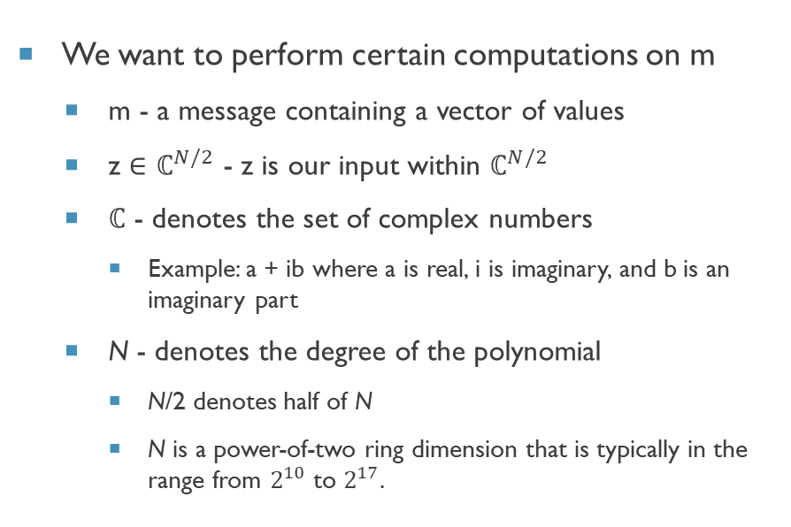
Step 1 - Message
We want to perform certain computations on m
m - a message containing a vector of values
z $∈$ $ℂ^{N/2}$ - z is our input within $ℂ^{N/2}$
$ℂ$ - denotes the set of complex numbers
Example: a + ib where a is real, i is imaginary, and b is an imaginary part
N - denotes the degree of the polynomial
N/2 denotes half of N
N is a power-of-two ring dimension that is typically in the range from $2^{10}$ to $2^{17}$.

Slide 5

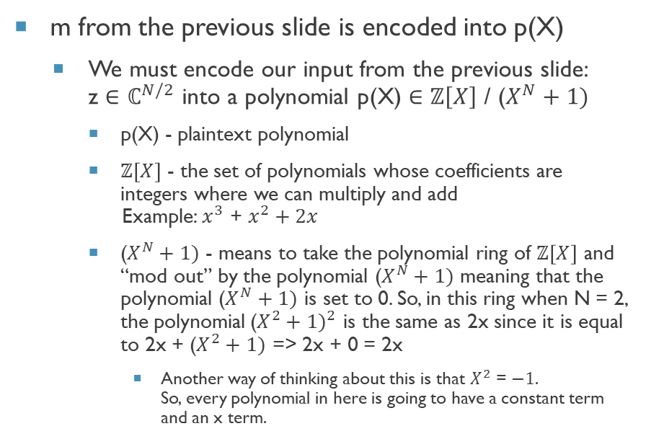
Step 2 - Encoding
m from the previous slide is encoded into p(X)
We must encode our input from the previous slide: z $∈$ $ℂ^{N/2}$ into a polynomial p(X) $∈$ $ℤ\left[X\right]$ / ($X^{N}+1)$
p(X) - plaintext polynomial
$ℤ\left[X\right]$ - the set of polynomials whose coefficients are integers where we can multiply and add Example: $x^{3}$ + $x^{2}+2x$
($X^{N}+1)$ - means to take the polynomial ring of $ℤ\left[X\right]$ and “mod out” by the polynomial ($X^{N}+1)$ meaning that the polynomial ($X^{N}+1)$ is set to 0. So, in this ring when N = 2, the polynomial${\text{(}X^{2}+1)}^{2}$ is the same as 2x since it is equal to 2x + ($X^{2}+1)$ => 2x + 0 = 2x
Another way of thinking about this is that $X^{2}$ = $−1$. So, every polynomial in here is going to have a constant term and an x term.

Slide 6
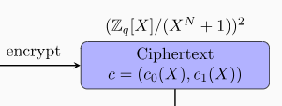
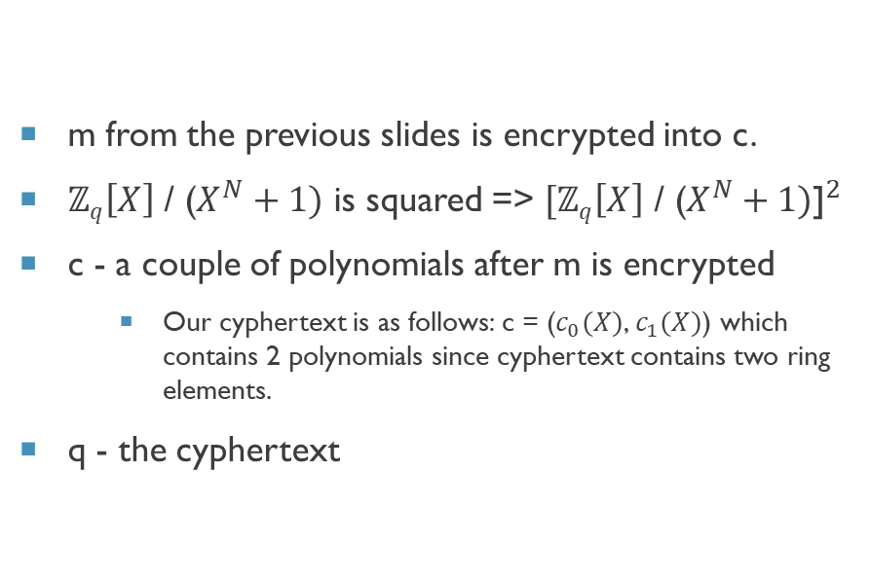
Step 3 - Encrypting
m from the previous slides is encrypted into c.
$ℤq\left[X\right]$ / ($X^{N}+1)$ is squared => ${[ℤq\left[X\right]\text{ / (}X^{N}+1)\text{]}}^{2}$
c - a couple of polynomials after m is encrypted
Our cyphertext is as follows: c = ($c_{0}(X)$, $c_{1}(X)$) which contains 2 polynomials since cyphertext contains two ring elements.
q - the cyphertext

Slide 7
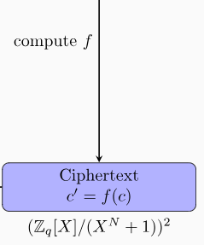
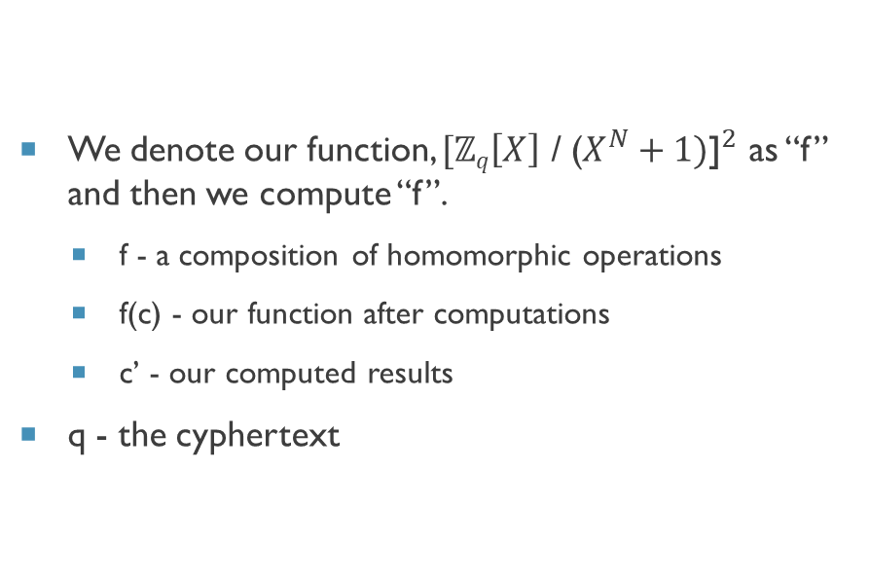
Step 4 - Computing
We denote our function, ${[ℤq\left[X\right]\text{ / (}X^{N}+1)\text{]}}^{2}$ as “f” and then we compute “f”.
f - a composition of homomorphic operations
f(c) - our function after computations
c’ - our computed results
q - the cyphertext

Slide 8
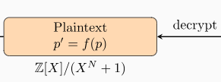
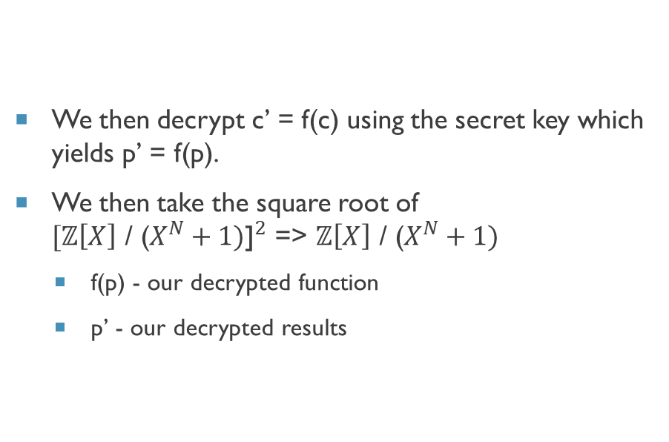
Step 5 - Decrypting
We then decrypt c’ = f(c) using the secret key which yields p’ = f(p).
We then take the square root of ${[ℤ\left[X\right]\text{ / (}X^{N}+1)\text{]}}^{2}$ => $ℤ\left[X\right]\text{ / (}X^{N}+1)$
f(p) - our decrypted function
p’ - our decrypted results

Slide 9
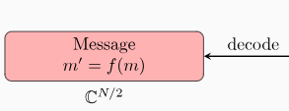
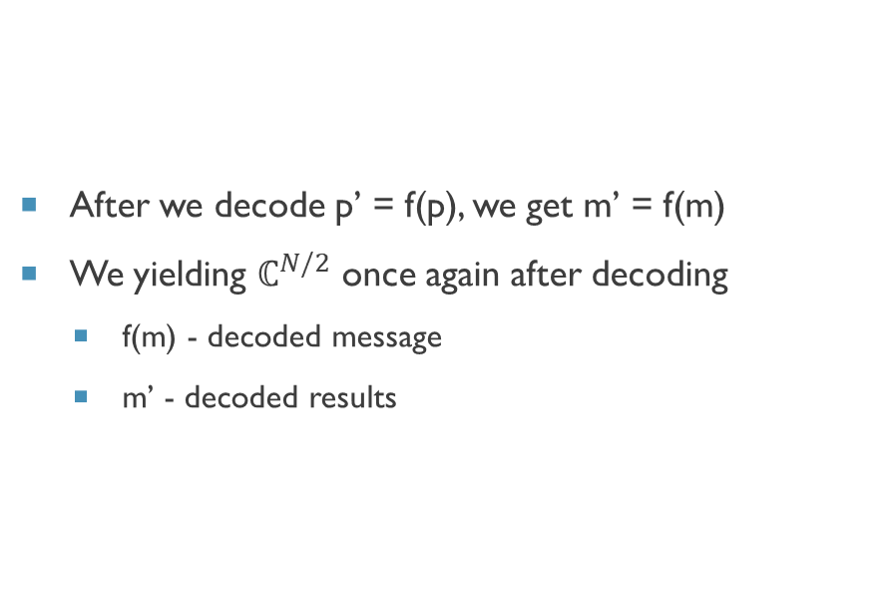
Step 6 - Decoding
After we decode p’ = f(p), we get m’ = f(m)
We yielding $ℂ^{N/2}$ once again after decoding
f(m) - decoded message
m’ - decoded results

Slide 10
References
Ring Theory (Math 113), Summer 2016 - University of California, Berkeley, math.berkeley.edu/~mcivor/math113su16/113ringnotes2016.pdf. Accessed 13 Oct. 2023.
Huynh, Daniel. “CKKS Explained: Part 1, Vanilla Encoding and Decoding.” OpenMined Blog, OpenMined Blog, 15 Mar. 2021, blog.openmined.org/ckks-explained-part-1-simple-encoding-and-decoding/.
OpenFHE: Open-Source Fully Homomorphic Encryption Library - IACR, eprint.iacr.org/2022/915.pdf. Accessed 13 Oct. 2023.

Slide 11

Thank You
fr015568@ucf.edu
321-603-9123

